Slide 1
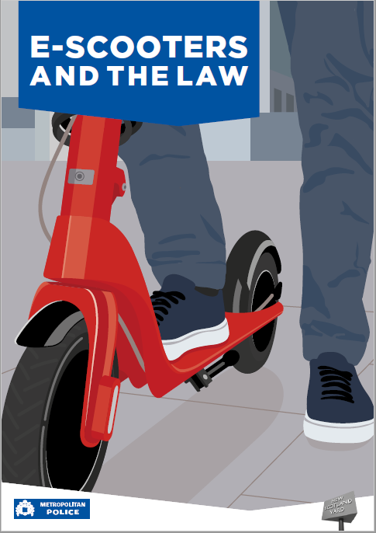
If you have questions email Pc Smith from Roads and transport
Dave.A.Smith3@met.police.uk

Slide 2
Currently in the UK, you can legally buy an e-scooter but you cannot ride it on a public road, cycle lane or pavement. The only place that it can be used is on private land.
The reason for this is that e- scooters are classed as motor vehicles by the department of transport and are subject to the same legal requirement as other vehicles, such as MOT, Licencing, tax and insurance. Because they do not have number plates, signalling ability or visible rear lights, they cannot be used legally on the roads or pavements.

Slide 3
What happens if I am stopped by the police?
The police will advise you on the law.
If caught riding the e scooter fines you receive can include.
A fixed penalty notice for no insurance, with £300 fine and six penalty points on your driving licence
A fixed penalty notice for no driving licence, up to a £100 fine and three to six points on your driving licence.
Other offences which may result in penalties include riding on a footpath, using mobile phone, riding through red lights and drink/drug driving offences.

Slide 4
The scooter that you own or are using will then be seized and taken to a car pound. Fees for recovering your E-scooters can be in excess of £200.
If you continue to ride your e scooter after you have been dealt with previously for riding the e – scooter you could eventually end up being disqualified from driving.
Please note that if your thinking its ok because you have not got a driving licence, DVLA will issue you a Ghost licence, this means when you eventually apply for your licence your points and offences will be added to your licence.

Slide 5
Some of you must be thinking that it is legal to ride e-scooters in some parts of London, if your thinking this you are correct. The areas in which E scooters are allowed to be used are in specific areas only. These are HIRE scooters and can only be used if the rider has a minimum of a provisional driving licence, riders also need to insured to ride the scooters, all this is completed prior to you riding them.
There has been a significant increase in road traffic accidents involving e-scooters which have included several fatalities, members of the public have also been injured due to e-scooters being driven on footways.

Slide 6
What electric vehicle can I use?
* You can you pedal bicycles which are assisting by an electric motor, these are not considered in law to be a mechanically propelled vehicle.
*******************
This small presentation is to educate both students and their families surrounding the laws around E-scooters.
If you wish any further information regarding the use of e-scooters please contact me on the email listed. Please stay safe!!

